Slide 2
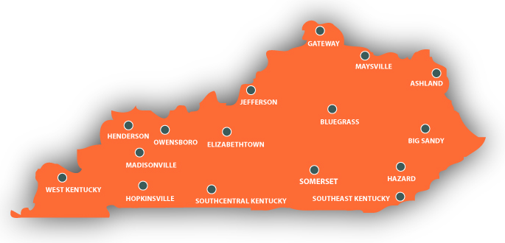
KCTCS is Statewide

Slide 3
Our Unique Mission
To improve the quality of lives and employability of Kentuckians by serving as the primary provider of:
College and workforce readiness
Transfer education
Workforce education and training

Slide 4
Workforce Training by the Numbers
Award 98% of all short-term certificates in Kentucky
Train 82% of Kentucky’s skilled trades workers
Award 66% of Kentucky’s nursing and allied health credentials

Slide 5
Workforce Solutions
Our statewide system of colleges provides customized training and support services to businesses and organizations across the Commonwealth.
Programs are available to help individuals upgrade their skills or meet continuing education needs.

Slide 6
Workforce Solutions
As Kentucky's primary provider of workforce education, KCTCS works to:
Develop and strengthen Kentucky’s workforce
Equip today’s workforce with knowledge and skills for the jobs of the future
Support the Commonwealth in competing for and sustaining businesses that thrive on innovative ideas and technologies
Provide Kentucky’s workers with world-class transferable skills
Strengthen and improve state and local economies

Slide 7
Workforce Solutions
KCTCS College Workforce Solutions are results-oriented training providers, with a track record of success in providing workforce solutions to 5,000 Kentucky companies annually.
KCTCS colleges provide training in multiple formats, making it easy to find the solutions that work for you and your company

Slide 8
Business & Industry Training
Degree/Continuing Education
Workforce Assessments

Slide 9
Workforce Solutions
Business & Industry Customized Training
Based on Company Needs Analysis
Flexible Scheduling & Delivery
Anytime/Anywhere Training – NOT Semester Based
Training Can Be Credit or Non-Credit
Current Demand – Technical Training & Supervision/Leadership
Smaller Class Sizes

Slide 10
Workforce Solutions
Customized Courses
Short-term Training for Specific Jobs
Usually 2 to 6 weeks
Built on Demand
Continuing Education: Maintain Licensure or Learn New Skills
Electricians – HVAC Technicians – Plumbers - Insurance Agents
Open Enrollment Classes
Classes to Prepare for Licensing Exams and Industry Certifications
Supervision & Leadership
Essential (Soft) Skills, Microsoft Office, and more

Slide 11
Workforce Solutions
Workforce Assessment Centers
Industry Based Assessments –
IT Assessments (Microsoft – Cisco – CompTIA)
GED
US Postal Service
KY Licensing Exams
Electricians
HVAC Technicians
KY Nurse Aid
Insurance Agents
EMT & Paramedic

Slide 12
KCTCS TRAINS
Through the KCTCS-TRAINS program, KCTCS can provide funding for companies to help offset the cost of training their employees.
Training can include coursework from supervisory and teamwork skills to technical skills.

Slide 13
KCTCS TRAINS
TRAINS funds cover 50% of the cost of training; the company covers 50% plus a 10% administration fee
Single or Multi-Company Projects
Customized to business needs
Flexible delivery system

Slide 14
Pipeline of Future Workers includes:
106 Technical Programs
Certificates, Diplomas, and Degrees
Business Technology, Culinary Arts, Skilled Trades
Accelerated terms and times
Credit for Prior Learning
Apprenticeships
Full or Part-time Employment

Slide 15
Economic Impact
Companies locating or expanding in KY look for …..
Quality of Life

