Slide 1
US and Kentucky Hotel Trends
Lyse Perrigo
Senior BD Associate
lperrigo@str.com
@STR_Data

Slide 2
Agenda
Total U.S. Overview
State of Kentucky
Event Performance
Pipeline
Forecast

Slide 3

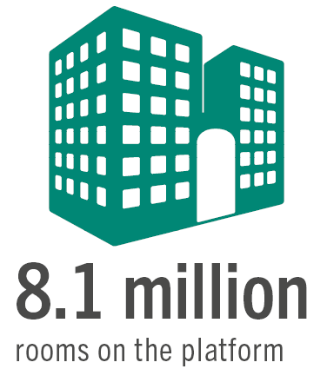

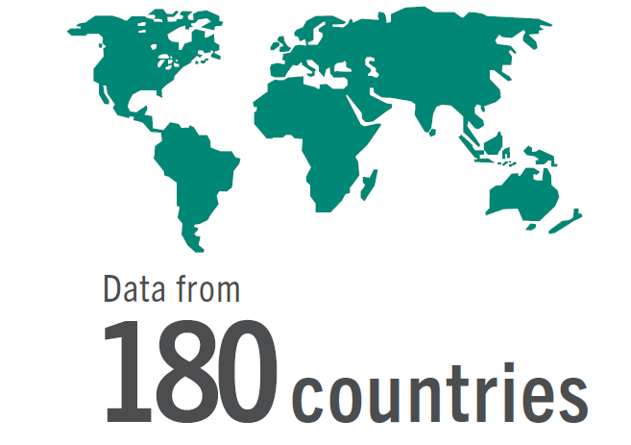
The world’s largest hotel performance sample
64,000
8.7 million
180
Notes:
STR collect performance data, with a focus on hotels
1985
Started Carolyn & Randy
Global presence
58k hotels
7.8 million rooms
Across 180 countries

Slide 4
Demand Growth Trajectory Slows. Supply Growth Still At 2%
Total U.S., Supply & Demand % Change, 12 MMA 1/1990 – 03/2019
Notes:
rooms supply change (+2%) was equal to the room demand change (+2%).
Demand growth is the lowest it’s been since 2010
any demand increase below +2.5% will lead to occupancy declines

Slide 5
Occupancy Growth Still Positive Nine Years Into the Cycle (…but barely)
Total U.S., ADR & OCC % Change, 12 MMA 1/1990 – 03/2019

Slide 6
March 2019: Poor Showing In An “Easter Comp” Month.
 |  | % Change
Room Supply |  | 2.0%
Room Demand |  | 2.0%
Occupancy | 68.4% | 0.0%
ADR | $133 | 0.6%
RevPAR | $91 | 0.6%
Room Revenue |  | 3.5%
Total US Results, March 2019
Notes:
RevPAR growth was +0.6%, which means that the Q1 result was +1.5%, well below expectations
ADR was only up +0.6% which is the lowest increase in room rate since June 2010
The RevPAR upcycle is now in month 109
We recorded the highest March occupancy ever, but ADR change was the lowest March change this cycle
one-third of all March US RevPAR growth was generated by San Francisco

Slide 7
Expense growth continues to outpace revenue gains
Source: 2019 HOST Almanac
Notes:
RevPAR revenues increased 2.4%
Rooms Expense( +3.3%) outpaced rooms revenue per available room (RevPAR) growth (+2.4%), but F&B and Other departments had higher revenues than expenses
Miscellaneous Income had the largest revenue increase at 11.3% - the highest we’ve seen, largely due to continued emphasis on fee-based revenues including cancellation fees and resort fees
Labor costs increased 4.0% in 2018, up again to higher levels as seen in 2016 and 2015 , and much higher than revenue growth – the 3rd consecutive year labor growth outpaced revenue growth

Slide 8
State of Kentucky Performance

Slide 9
Supply and Demand growth on the rebound
Total U.S., Supply & Demand % Change, 12 MMA 1/1990 – 03/2019
Notes:
Since the close of the convention center, supply has been outpacing demand. I expect this is due to less group business, over 1,000 rooms have been added since 2016 including a 600 romm Omni a block away.

Slide 10
ADR growth remained positive during KICC closure
Total U.S., ADR & OCC % Change, 12 MMA 1/1990 – 03/2019
Notes:
While occupancy growth was negative during the closure, ADR growth was still strong around the 2% market. I expect we will continue to see ADR growth and occupancy growth looks like it may be on an uphill swing with the return of group business

Slide 11
Demand Growth is Transient Driven
Avg Transient ADR: $94.32
Avg Group ADR: $92.38
*Total Number of Rooms Sold, Group and Transient, by year 2013 – 2019 YTD
Notes:
Looking at segmentation data,demand growth has been consistently transient driven and growing while group demand has remained steady even during the closure of the convention center wasn’t hit to hard. It will be interesting to watch group demand in 2019 with a full year of the new convention business

Slide 12
2018 Year in Review: the KICC effect
KY December 2018 YTD YOY % Change
Notes:
August 2018 was the month with the biggest decline in occupancy while april and November are the only two months that saw positive growth. As the year progressed with the reopening of the convention center, ADR growth saw it’s best month in November driving revpar for a year high of 3.7% growth. The 13% increase in supply was the key contributor to the occupancy decline and the ADR growth was not enough to cover the decline during the closure.

Slide 13
Kentucky Q1 2019 Performance
 | Actual | % Change
Room Supply |  | 4.8% | p
Room Demand |  | 6.5% | p
Occupancy | 50.3% | 1.6% | p
ADR | $95.17 | 3.6% | p
RevPAR | $47.86 | 5.2% | p
State of Kentucky YTD March 2019
Notes:
2019 is off to a great start. Q1 in review – demand is outpacing supply by a little over 2%. KY is seeing growth across all metric including a 5% increase in revpar. This is the highest demand growth since quarter 3 of 2010 (the year after the recession)

Slide 14
March 2019 was record breaking
 | Highest Ever? |  | % Change
Room Supply | ☑ |  | 3.7%
Room Demand | ☑ |  | 5.9%
Occupancy | 63.9% | 60.8% | 0.5%
ADR | ☑ | $104.41 | 2.4%
RevPAR | $63.96 | $63.49 | 2.9%
Room Revenue | ☑ |  | 10.4%
State of KY Results, 2019 March 12MMA
Notes:
Highest supply, demand, revenue ever recorded. So the new supply does not seem to be effecting business even with 3.7 growth we are still seeing occ growth while minimal, With more revnue, comes pricing power –this is the highest ADR Growth KY has seen.

Slide 16
Supply/Demand % Change by Market
*Supply / Demand % Change, by Market, March 2019 12MMA
Notes:
5 markets supply is outpacing their demand. Cincinnati is the only market where demand is outpacing supply

Slide 17
Reopening of convention center leads to a booming Louisville
March 2019 YTD YOY % Change
Notes:
Louisville hoteliers can rejoice with a 9% increase in revpar. Louisville is a strong market being accelerated by the reopening of the convention center. Lexington being effected by 2.5% supply increase.. Seeing a little adr growth but with the rate of inflation at 2% youre not able to make profit off .7% rate growth

Slide 18
Major Market Performance Q1 2019
March 2019 YTD YOY % Change
Notes:
All markets except Kentucky east experiencing occupancy growth in the first quarter. All markets exept ky west exepereicing adr growth

Slide 19
Market RevPAR Performance Q1 2019
March 2019 YTD YOY % Change
Notes:
ADR driving revpar for all smaller markets except ky west. Ky west being driven by 5.5% growth in occupancy

Slide 20
Market Events

Slide 21
Special Event Market Performance 2018
Average Occ & ADR across event days in 2018

Slide 22
Spring Quilt Week 2018
Paducah, KY April 18-21
*First 3 days of Spring Quilt Week vs. 3 year average RevPAR by day of week period

Slide 23
Horsey Hundred 2018
Georgetown May 25-26
*First 3 days of Horsey Hundred vs. 3 year average RevPAR by day of week period

Slide 24
Michelin National Corvette Bash 2018
Bowling Green April 26-28
*First 3 days of Corvette Bash vs. 3 year average RevPAR by day of week period

Slide 25
Hillbilly Days 2018
Pikeville April 19-21
*First 3 days of Hillbilly Days vs. 3 year average RevPAR by day of week period

Slide 26


Pipeline

Slide 27
US Pipeline: I/C Rooms Increase, But Still Manageable
Phase | 2019 | 2018 | % Change
In Construction | 201 | 186 | 7.7%
Final Planning | 197 | 221 | -10.9%
Planning | 260 | 181 | 44.1%
Under Contract | 658 | 588 | 11.9%
*Total US Pipeline, by Phase, ‘000s Rooms, March 2019 and 2018
Notes:
In Construction rooms count is 201,000, +7.7%, which is the highest change since August 2017. the brunt of construction is limited service. 260 in planning – around 40% will never see opening day

Slide 28
I/C Pipeline Is Still Below Prior Peak (But Slowly Creeping Up)
10K
Thousands
*Total US Pipeline; Rooms In Construction, in ‘000s; 01/2006 – 03/2019
Notes:
Weve seen some few hiccups, since October 2016 the growth rate has stayed manageable, growth around 2% which lands us at 201k as of March

Slide 29
In Construction Rooms Are Dominated By Two Players: Hilton & Marriott
*US Pipeline, Rooms In Construction, Share of HLT & MAR of total, March 2019

Slide 30
Kentucky- Increases in Supply to Come
Phase | Projects | Rooms
In Construction | 23 | 2,384
Final Planning | 21 | 1,885
Planning | 25 | 2,252
Total Under Contract Pipeline | 69 | 6521
Notes:
30% under contract are within the upper midscale class. 27 projects in Louisville alone and 12 in cinncinnati and 6 in bowling green. The largest project being added is an Autograph Collection with 205 rooms and 4,000 sq ft of meeting room space in louisville

Slide 31
Forecast

Slide 32

Total United States
Key Performance Indicator Outlook (% Change vs. Prior Year)
2019F – 2020F
Outlook
Metric | 2019 Forecast | 2020 Forecast
Supply | 1.9% | 1.9%
Demand | 1.9% | 1.7%
Occupancy | 0.0% | -0.2%
ADR | 2.3% | 2.2%
RevPAR | 2.3% | 1.9%

Slide 33
Total United States
Chain Scale Key Performance Indicator Outlook
2019F by Chain Scale
2019 Year End Outlook
Chain Scale | Occupancy (% chg) | ADR (% chg) | RevPAR (% chg)
Luxury | -0.2% | 2.5% | 2.3%
Upper Upscale | -0.1% | 2.2% | 2.2%
Upscale | -0.1% | 1.9% | 1.8%
Upper Midscale | -0.1% | 1.8% | 1.7%
Midscale | 0.1% | 1.9% | 2.0%
Economy | -0.2% | 2.1% | 2.0%
Independent | -0.1% | 2.3% | 2.1%
Total United States | 0.0% | 2.3% | 2.3%
Notes:
Share of Total US Supply by Luxury, Economy and Independent: 45.3%
Share of Total US Revenue by Luxury, Economy and Independent: 40.1%
Luxury, Economy and Independent properties command 45.3% share of supply and 40.1% share of revenue. These two data points are the factors for RevPAR calculations. Due to this significant share, these properties have a bigger impact on overall US RevPAR of 2.4% although Upscale and Upper Midscale are expected to record growths less than 2.0%.

Slide 34
Total United States
Chain Scale Key Performance Indicator Outlook
2020F by Chain Scale
2020 Year End Outlook
Chain Scale | Occupancy (% chg) | ADR (% chg) | RevPAR (% chg)
Luxury | -0.3% | 2.4% | 2.1%
Upper Upscale | -0.3% | 2.2% | 1.9%
Upscale | -0.3% | 2.0% | 1.7%
Upper Midscale | -0.2% | 1.9% | 1.7%
Midscale | -0.3% | 1.7% | 1.4%
Economy | -0.2% | 2.0% | 1.9%
Independent | -0.4% | 2.0% | 1.5%
Total United States | -0.2 | 2.1% | 1.9%
Notes:
Share of Total US Supply by Luxury, Economy and Independent: 45.3%
Share of Total US Revenue by Luxury, Economy and Independent: 40.1%
Luxury, Economy and Independent properties command 45.3% share of supply and 40.1% share of revenue. These two data points are the factors for RevPAR calculations. Due to this significant share, these properties have a bigger impact on overall US RevPAR of 2.4% although Upscale and Upper Midscale are expected to record growths less than 2.0%.

